Slide 1
NTU/U Analysis

Slide 2
Introduction
This code is an example to just compute a passive regenerator based on a idealized balanced regenerator- or NTU example.
It will give you the possibility to understand how the solver works using a simplified example.
This is built out to the AMR model.

Slide 3








Governing Equations
Solid:
$$\frac{1}{U}\frac{∂θ_{r}}{∂t}+NTU\left(θ_{f}−θ_{r}\right)=0$$
$${0<t}^{n}<τ_{c}$$
$$\frac{∂θ_{f}}{∂x}+NTU\left(θ_{r}−θ_{f}\right)=0$$
$${0<t}^{n}<\frac{τ_{c}}{2}$$
Fluid:
$$\dot{m}\left(t^{n}\right)>0$$
$$\dot{m}\left(t^{n}\right)≤0$$
$$−\frac{∂θ_{f}}{∂x}+NTU\left(θ_{r}−θ_{f}\right)=0$$
$${\frac{τ_{c}}{2}<t}^{n}<τ_{c}$$

Slide 4
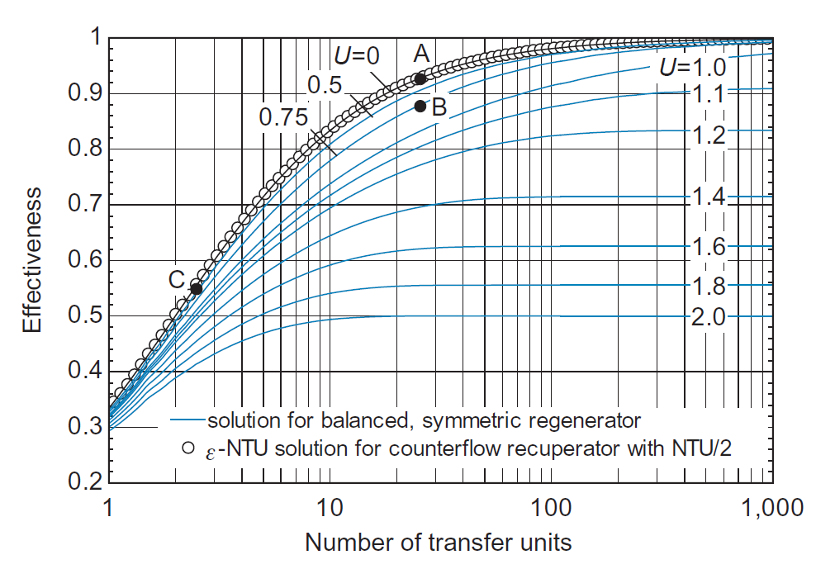
Results
N=100 nt=240 StepTol<1e-6 CycleTol<1e-6
Source: Heat Transfer – Gregory Nellis, Sanford Klein
Results from the Model

Slide 5
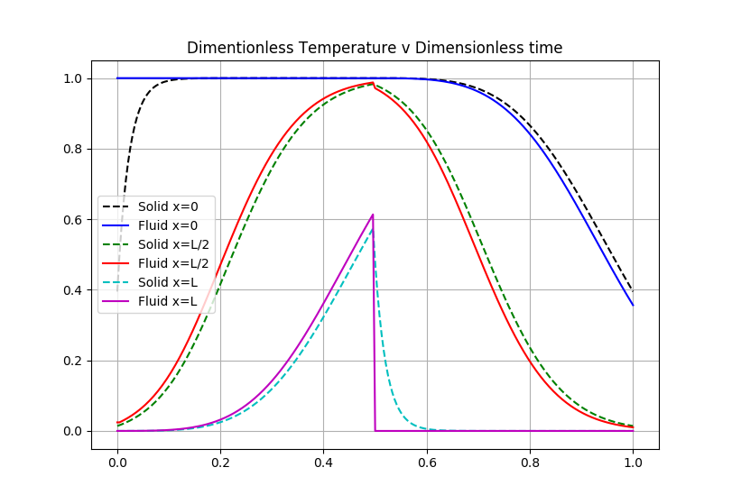
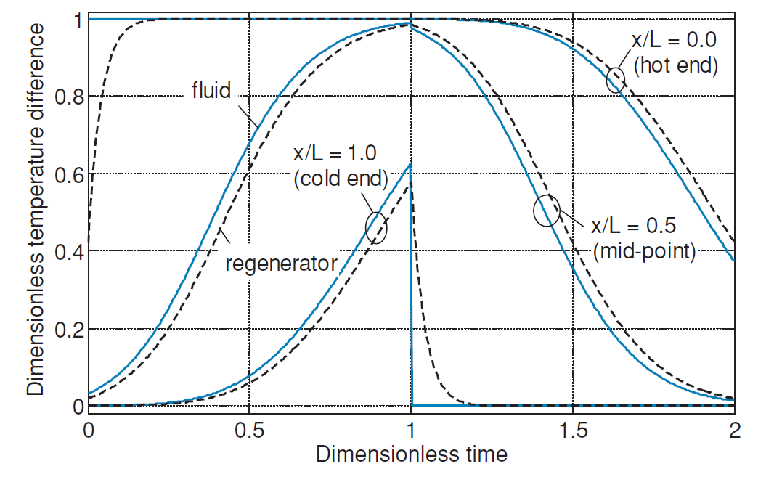
Cut Through
Source: Heat Transfer – Gregory Nellis, Sanford Klein
Results from the Model

Slide 6
Some Features of the code:
Boundary condition implementation
Upwinding on the forced convection term.
Sped up the solver(python -> C)

